Slide 1


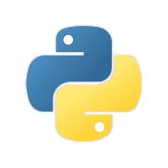
Python Program

Slide 2
Agenda
Python Introduction
Who Uses Python
Python Features
What Applications Can Build ?
Installations
Keywords in Python
Operators in Python
Flow Control
Functions in Python
Let’s Start

Slide 3
Python Introduction

Slide 4
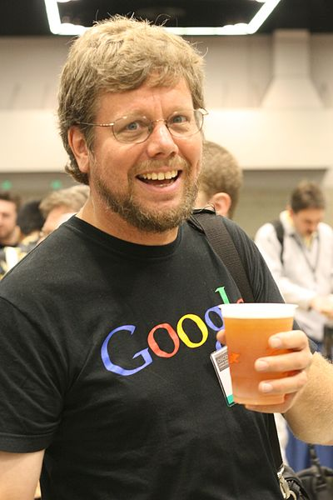
Introduction :
Python is a widely used high-level programming language for general-purpose programming, created by Guido Van Rossum and first released in 1991.
Python is named from name called “Monty Python”.
Python is a simple, easy to learn, powerful, high level and object-oriented programming language.
Python is a general purpose programming language created in the late 1980s, and named after Monty Python, that's used by thousands of people to do things from testing microchips at Intel, to powering Instagram, to building video games with the PyGame library.

Slide 5
Python is an interpreted, object-oriented, high-level programming language with dynamic semantics.

Slide 6
Who Uses Python ?

Slide 8



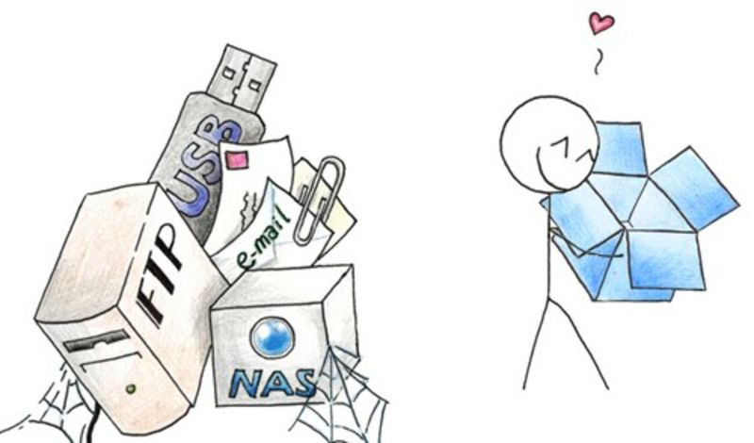
Using Top Companies:
YouTube is originally Written in Python and MySQL.
Yahoo Maps uses Python.
Many Components of the Google Spider and Search engine are Written in Python.
Dropbox web-based file hosting service is implemented using Python

Slide 9
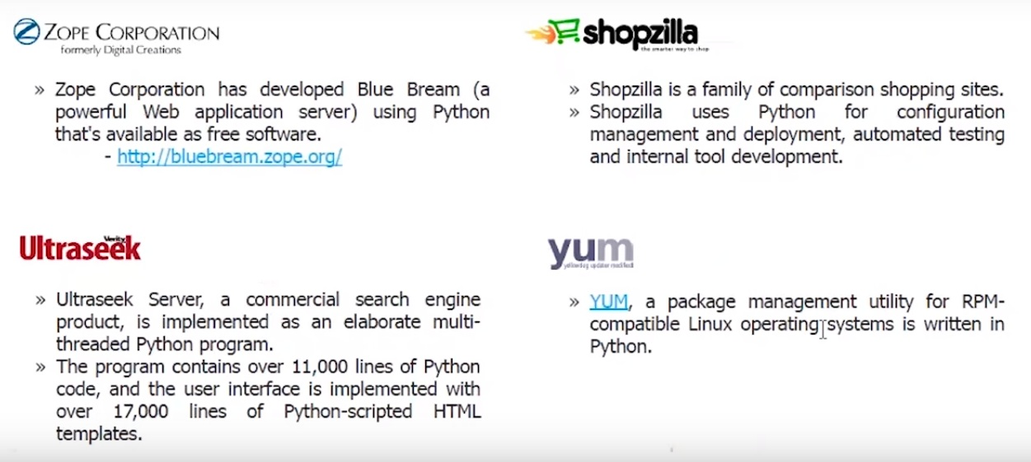
Using Top Companies:

Slide 10
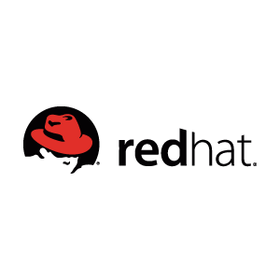
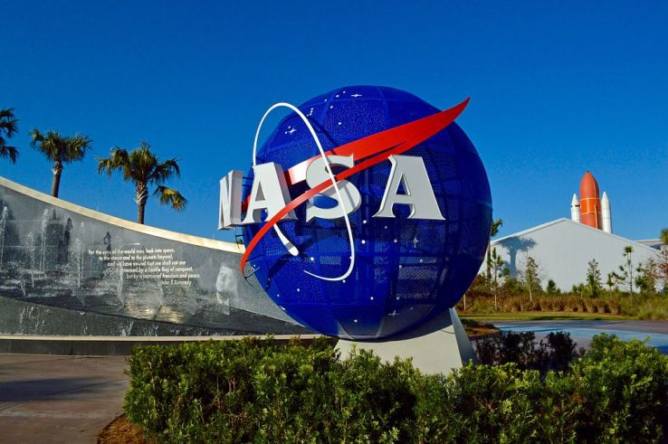




Using Top Companies:
NASA
Walt Disney
AlphaGene
RedHat
Nokia
IBM

Slide 11

Python Features

Slide 12
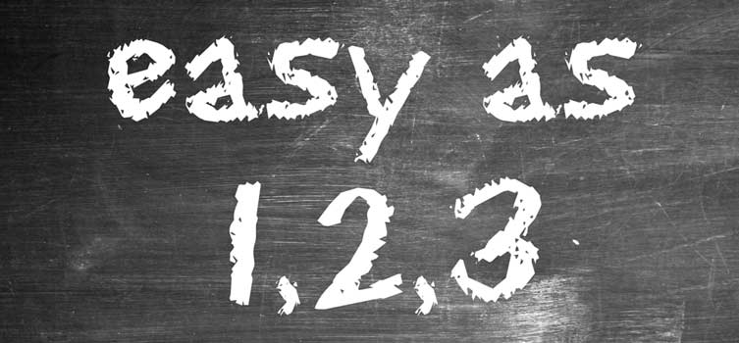
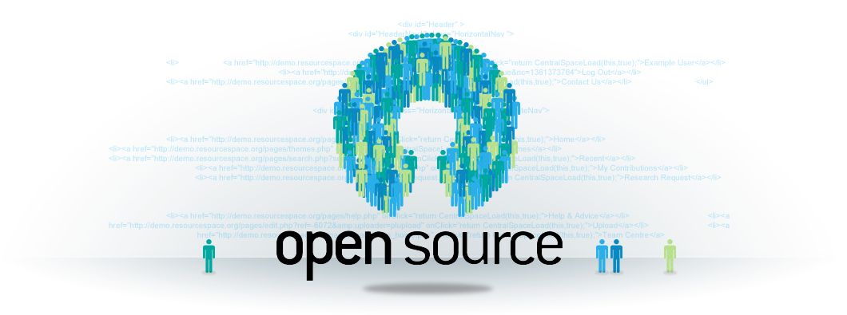
Python Features
Simple and Easy to Learn
Python is a simple and easy to learn, read & write
Free and Open Source
Python is an example of FLOSS(Free/Libre and Open Source
Software) which means one can freely distribute copies of this
software, read it’s source code, modify it, etc.

Slide 13
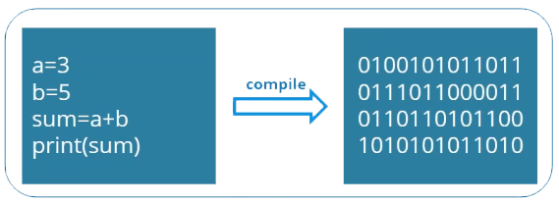

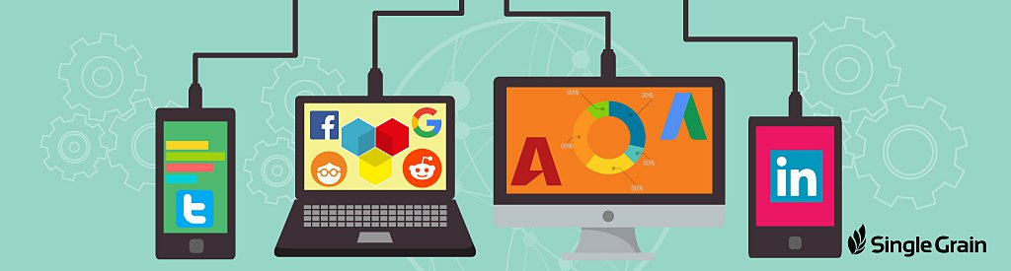
Python Features
High-level Language
One does not need to bother about the low-level
details like memory allocation, etc. while writing
Python Scripts
Portable
Supported by many platforms like Windows CE, Linux, Windows,
FreeBSD, Macintosh, Solaris, OS/2, Amiga, AROS, AS/400, BeOS,
OS/390, PlayStation, etc.

Slide 14
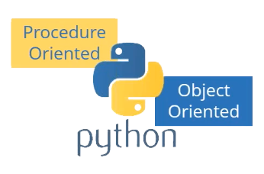
Python Features
Supports different Programming Paradigm
Python Supports procedure-oriented programming as well as
object-oriented programming.
Extensible
Python code can invoke C and C++ libraries, can be called from and C++ programs, can integrate with Java and . Net components
We can perform Cross-Language Operations

Slide 15
What
Applications
Can
Build

Slide 16

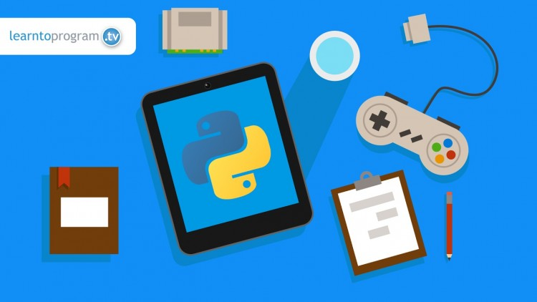
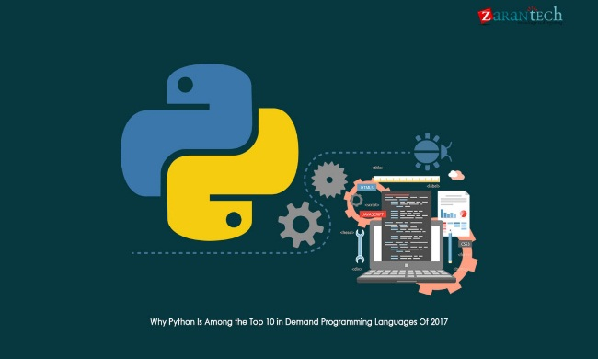
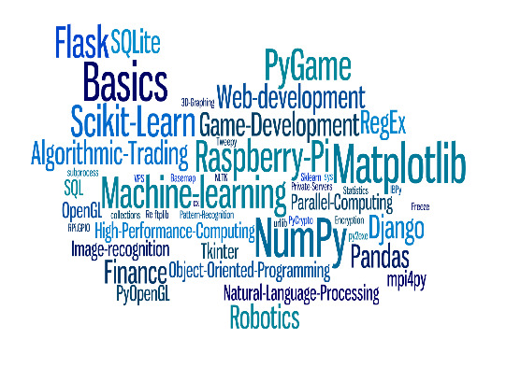
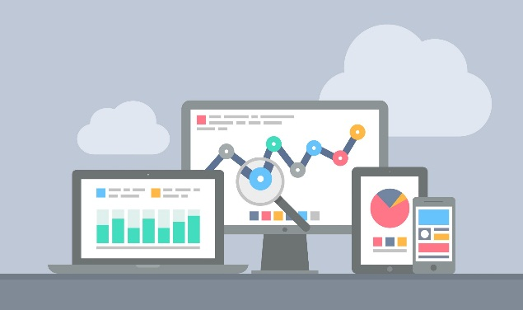
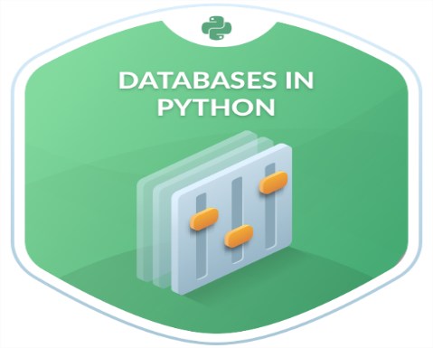
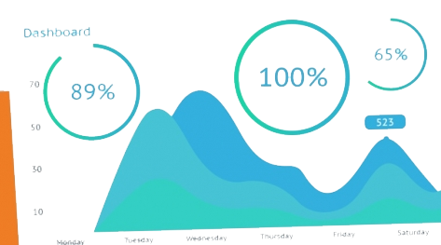
Applications :
The Python Package Index (PyPI) hosts thousands of third-party modules for Python.
Web and Internet Development
Database Access
Desktop GUIs(Graphical User Interface’s)
Scientific & Numeric
Network Programming
Software Development &
Game Development

Slide 17

Download & Installation

Slide 18
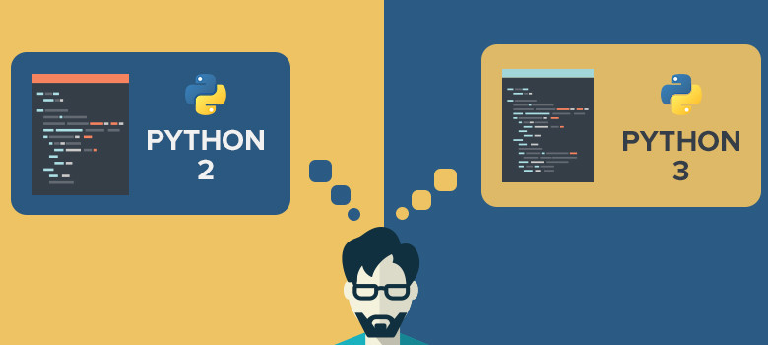
Versions :

Slide 19
Versions :
Python 2 | Python 3
print “Hello World..!” | Print(“Hello World..!”)
Less Support Documentation Libraries | More Support Documentation Libraries
Less Performance while Compare to Python3 | Better Performance
Not as ready | Ready to Move into the future(Updates)
No Full Support for Readymade Modules and Libraries | Full Support of Readymade Modules and Libraries

Slide 20
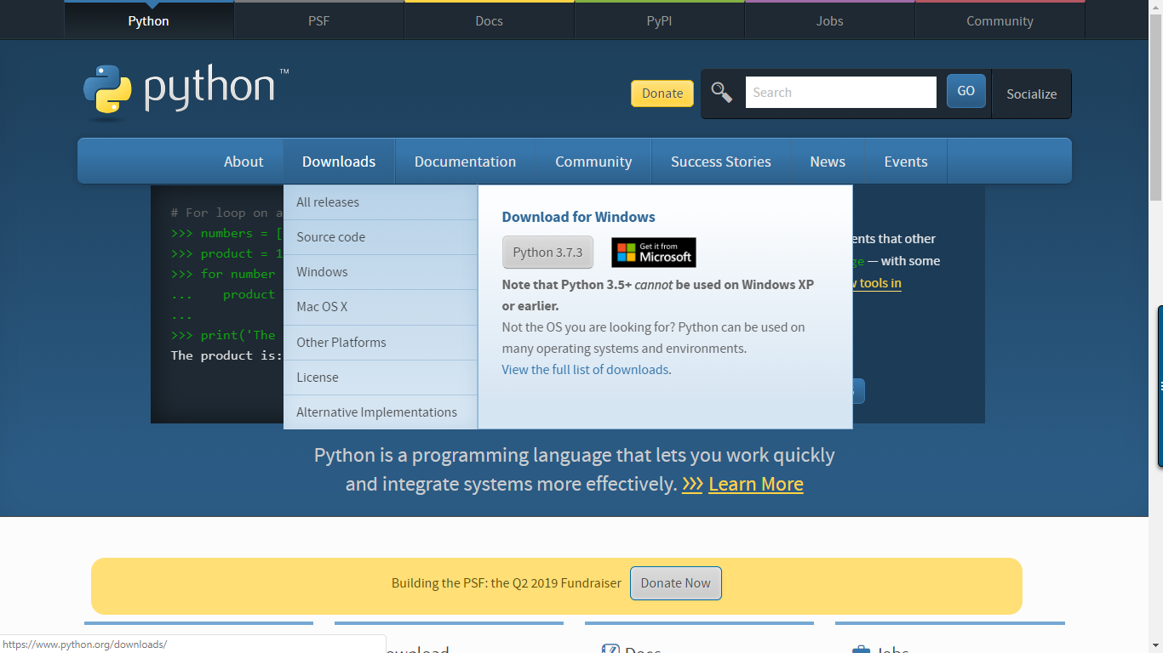

Slide 21

Keywords in Python

Slide 22
Keywords in Python :

Slide 23
Operators in Python

Slide 24
Operators in Python

Slide 25
Arithmetic Operators

Slide 26
Arithmetic Operators :

Slide 27
Arithmetic Operators :

Slide 28
Assignment Operators

Slide 29
Assignment Operators :

Slide 30
Comparison Operators

Slide 31
Comparison Operators :

Slide 32
Logical Operators

Slide 33
Logical Operators :

Slide 34
Bitwise Operators

Slide 35
Bitwise Operators :

Slide 36
Bitwise Operators :

Slide 37
Identity Operators

Slide 38
Identity Operators :

Slide 39
Membership Operators

Slide 40
Membership Operators :

Slide 41
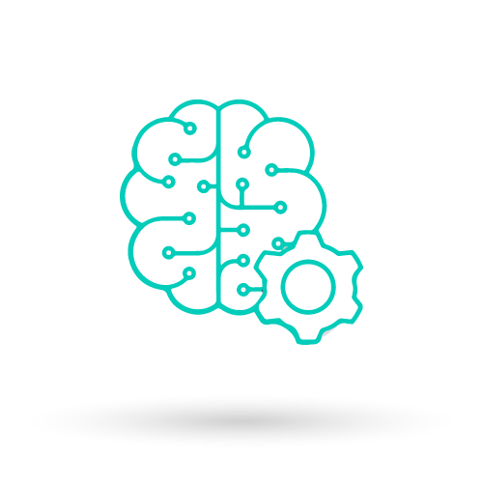
Flow Control

Slide 43
Flow Control :

Slide 44
Flow Control :

Slide 45
Flow Control :

Slide 46
Flow Control :

Slide 47
Flow Control :

Slide 48
Flow Control :

Slide 49
Flow Control :

Slide 50

Functions in Python

Slide 51
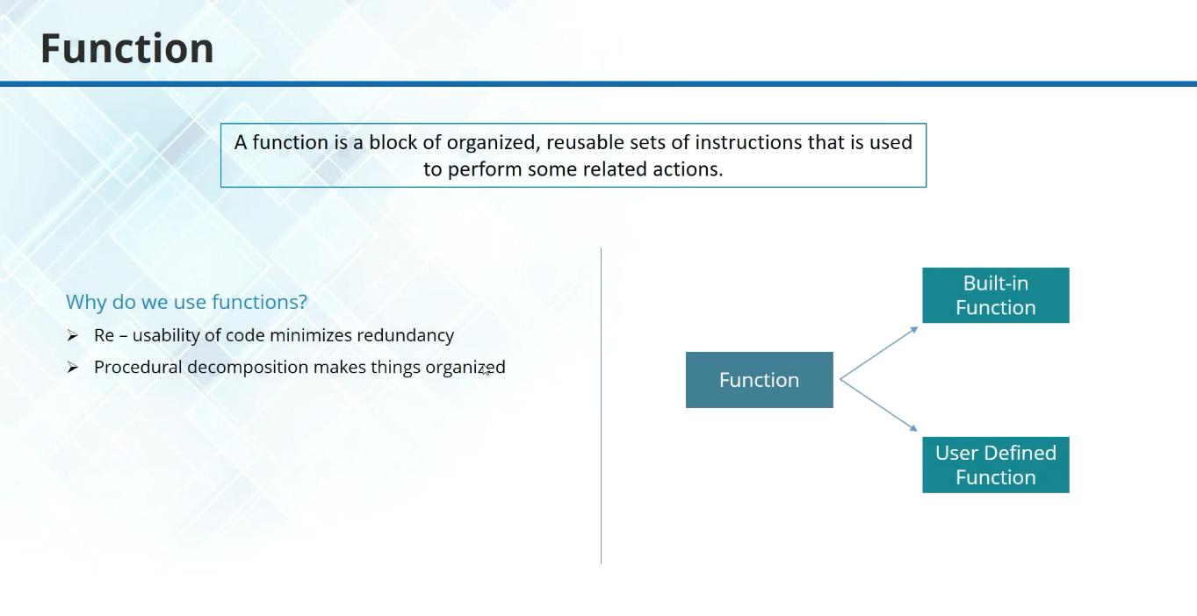

Slide 52



Slide 53
Python Workshop Syllabus Contents :
Next >>

Slide 54
Day-1
Topic name | Sub topics
Why We Program? , Python Installation Explanation | Introduction about Python , Characteristics, Features , Advantages.
 | Explanation about Python Installation , Path Setting , CMD , IDLE
Variables and Expressions | Variables, Statements
 | Python literals with examples.
Conditional Code , Loops and Iterations | if, else, elif , for , while with example program
Functions | Definition of function, How to define a function
 | function arguments with examples
Functions | example program using functions :
 | Take a break program
Strings | String definition and about string
 | Accessing values in strings , Updating strings.
 | Example Program using Strings

Slide 55
Day-2
Topic name | Sub topics
Strings | String methods
 | String Slicing with example program
Lists | Introduction to Lists , List operations with examples
 | Map and filters with examples
Lists | More Examples on List with Program
Tuples | About tuples, Packing and unpacking , Comparing tuples
Tuples | Using Tuples as Keys in Dictionaries
 | More Examples on Tuple with Program
Dictionaries | What is Dictionary ?, How to add and remove elements from dictionary
 | Example Program using Dictionaries
Dictionaries | getting values from dictionaries , Methods of dictionary
 | Practice

Slide 56
Day-3
Topic name | Sub topics
Python CGI | CGI Introduction, executing sample html and python files using CGI
Sqlite Database connections in Python using CGI | Sqlite3 DB with Python
Python CGI Crud Operations | Insert , Retrieve , Delete Operations using CGI
 | Practice for Update Operation using CGI
Mini Project | Mini Project using CGI
Explanation of coursera, LMS Exam | explanation about Certification course , LMS Exam

